Slide 1


Experimental Design Project
Michael Surface

Slide 2
Purpose
Does the amount of flour in a cookie mixture change the appearance of a cookie?
Latin-Square Design
Treatment: Amount of flour
Block 1(Row): Batches
Block 2(Column): Flavor of cookie
Experimental Unit: Average of 3 cookies for each combination of blocks and treatment
Response Variable: Radius

Slide 3
Randomization
Row | Chocolate Chip | Reese | Oatmeal Raisin
Batch 1 | 2 (1 ½ Cup) | 1 (3/4 Cup) | 3 (2 ¼ Cup)
Batch 2 | 3 | 2 | 1
Batch 3 | 1 | 3 | 2
Used Minitab to randomize the order of mixing cookies within each batch

Slide 4

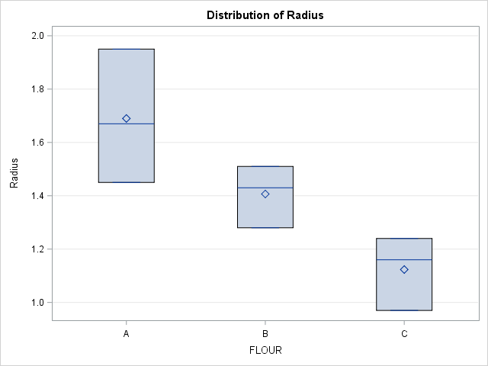

Results
Flour A = ¾ Cup
Flour B = 1 ½ Cup
Flour C = 2 ¼ Cup

Slide 5
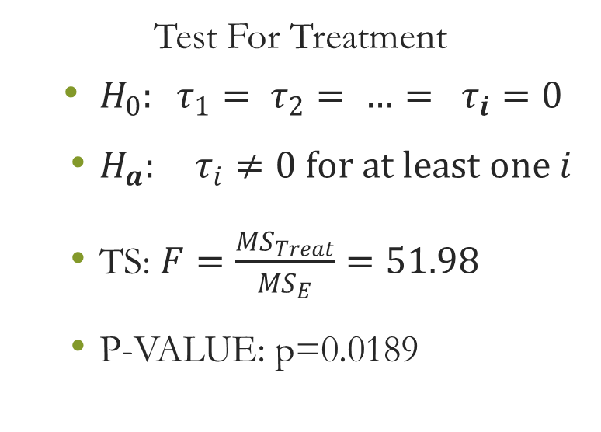
Tests for Significance
Test For Treatment
$H_{0}: τ_{1}= τ_{2}= …= τ_{i}=0$
$H_{a}: τ_{i}≠0 for at least one i$
TS: $F=\frac{{MS}_{Treat}}{{MS}_{E}}=51.98$
P-VALUE: p=0.0189
Test For Flavor/Batch Oder
Flavor:
TS: F=18.07
P-VALUE: p=0.0524
Batch:
TS: F=1.58
P-VALUE: p=0.3883

Slide 6
Tukey Comparison
Lines Procedure at the 5% Significance Level
Flour Amount(cups) ¾ 1 ½ 2 ¼
Mean(inches) 1.69 1.41 1.12

Slide 7
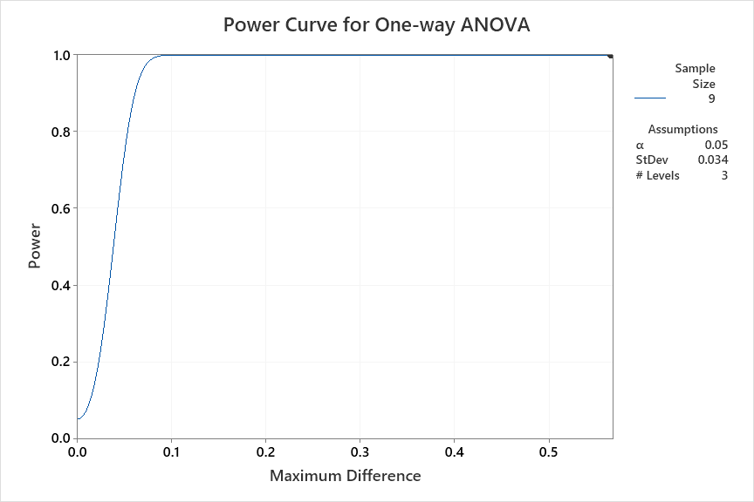
Power
Results
Maximum Difference Sample Size Power
0.5667 9 1
The sample size is for each level.

Slide 8
Conclusion
Less flour results in a larger radius for cookies
Flour amount was significant for this experiment
The blocks of time order for baking and flavor type were not significant

